Slide 1
Speaker Guidance
Speaker | Field Marketer, AM/ATS, EBC presenter
Content Level | Level 200 – customer-ready
Audience | Line of Business and Data Developers; IT Pros; Data Scientists / Analysts; ISV/Sis
Title | Cortana Intelligence Suite: Cognitive Services
Objective | Educate customers and partners on the Cognitive Services capabilities of Cortana Intelligence Suite
Deck contact | Giampaolo Battaglia
Version | Last updated March 2016
Length & timing guidance | 75 minutes – suggested timing: Introduction Cortana Intelligence: 7 minutes Cognitive Services Overview: 5 minutes Vision APIs: 10 minutes Speech APIs: 10 minutes Language APIs: 10 minutes Knowledge APIs: 10 minutes Search APIs: 10 minutes Close: 3 minutes Q+A: 10 minutes
Speaker Guidance – Do Not Present

Slide 2
Cortana Intelligence Suite
Cognitive Services
Notes:
Hi, I’m ___, and I’m excited to discuss Microsoft’s Cortana Intelligence Suite, and the value it can deliver to your organization.
More specifically, we’re going to talk about Microsoft Cognitive Services.

Slide 3
Business is being transformed by three trends
Big Data
Cloud
Intelligence
Notes:
But first, let me provide you a quick overview about how business is being transformed by three trends.
Today, the world around us is rapidly changing, faster than at any other point in history. This is an indicator of the fourth industrial revolution that is emerging, largely driven by the rise of Big Data, the growth of the cloud, and a new era of intelligence capabilities.
Thanks to the exponential proliferation of small, inexpensive chips and processors, computers are as ubiquitous as the people who use them – from traditional computers, tablets and phones to sensors and wearables. Machines are everywhere, constantly creating, collecting and making sense of the data in our midst. With the magic of machine learning and the limitless computing power of the cloud, this data is giving rise to intelligence that is augmenting human capabilities in exciting new ways.
Together, these technologies have the power to disrupt almost every industry, which is why this era is being heralded as the fourth industrial revolution. The breadth and depth of these changes is resulting in the transformation of entire systems of production, management, and governance.
At Microsoft, our ambition is to democratize the fourth industrial revolution by providing the building blocks to empower organizations large & small – enabling them to build, innovate and transform, and allowing them to get started quickly and see real business impact and results fast. We believe an organization’s data is a key strategic asset which, when combined with the cloud and the potential of intelligence capabilities, provides the opportunity to automate, innovate and increase the speed of business.
<Transition>: Our Cortana Intelligence Suite is designed to help you capitalize on these trends.

Slide 4



Stay ahead of the curve with Cortana Intelligence Suite
Business apps
People
Custom apps
Apps
Sensors and devices
Cortana Intelligence
Automated systems
Data
Intelligence
Action
Notes:
Cortana Intelligence is Microsoft’s fully managed intelligent, big data and advanced analytics offering in the cloud, designed to help you transform your data into intelligent action.
It is a comprehensive suite that brings together technologies throughout Microsoft. It provides fast and flexible deployment, with a simple monthly subscription to reduce time and cost challenges.
Cortana Intelligence enables customers to benefit from Microsoft’s investment in the intelligent cloud and advanced analytics, spanning our leading cloud platform with easy to use tools and services that integrate with existing infrastructure and enable enterprises to extend business solutions as their needs grow over time.
With Cortana Intelligence, we are taking years of research and innovation – spanning technology & infrastructure for advanced analytics, including capabilities such as machine learning, big data storage and processing in the cloud, intelligence capabilities like vision, face and speech recognition, and integration with Cortana, Microsoft’s personal digital assistant, with the goal of helping enterprise customers make better, faster decisions to accelerate their speed of business.
<Transition>: Let’s talk about how some of our customers are benefiting from Cortana Intelligence.

Slide 5



Easily turn data into intelligent action
Information Management
Big Data Stores
Machine Learning and Analytics
Intelligence
Data Sources
People
Data Factory
Data Lake Store
Machine Learning
Cognitive Services
Data Catalog
SQL Data
Warehouse
Data Lake Analytics
Bot Framework
Web
Apps
HDInsight
(Hadoop and Spark)
Event Hubs
Cortana
Mobile
Apps
Stream Analytics
Bots
Dashboards & Visualizations
Sensors and devices
Power BI
Automated Systems
Data
Intelligence
Action
Notes:
Cortana Intelligence delivers an end-to-end platform with an integrated and comprehensive set of tools and services to help you build intelligent applications that let you easily take advantage of Advanced Analytics and intelligence capabilities.
First, Cortana Intelligence provides services to bring data in, so that you can analyze it. It provides information management capabilities like Azure Data Factory so that you can pull data from any source (relational DB like SQL or non-relational ones like your Hadoop cluster) in an automated and scheduled way, while performing the necessary data transforms (like setting certain data columns as dates vs. currency etc). Think ETL (Extract, Transform, Load) in the cloud. Event Hubs does the same for IoT type ingestion of data that streams in from lots of end points.
The data brought in then can be persisted in flexible big data storage services like Data Lake Store and Azure SQL Data Warehouse.
You can then use a wide range of analytics services from Machine Learning to Azure Data Lake Analytics to Azure HDInsight to Azure Stream Analytics to analyze the data stored in the big data storage. This means you can create analytics services and models specific to your business need (say real time demand forecasting).
The resultant analytics services and models created by taking these steps can then be surfaced as interactive dashboards and visualizations via Power BI.
These same analytics services and models created can also be integrated into various different UI (web apps or mobile apps or rich client apps), or with Cortana, so end users can naturally interact with them via speech etc., and so that end users can get proactively be notified by Cortana if the analytics model finds a new anomaly (unusual growth in certain product purchases- in the case of real time demand forecasting example given above) or whatever deserves the attention of the business users. Similar integration can occur with Cognitive Services or Bot Framework based applications.
At a high level though, Cortana Intelligence capabilities are in three main areas: data, analytics and intelligence.
<Transition>: We’re going to dive into each one.

Slide 6
Easily turn data into intelligent action
Information Management
Big Data Stores
Machine Learning and Analytics
Intelligence
Data Sources
People
Data Factory
Data Lake Store
Machine Learning
Cognitive Services
Data Catalog
SQL Data
Warehouse
Data Lake Analytics
Bot Framework
Web
Apps
HDInsight
(Hadoop and Spark)
Event Hubs
Cortana
Mobile
Apps
Stream Analytics
Bots
Dashboards & Visualizations
Sensors and devices
Power BI
Automated Systems
Data
Intelligence
Action
Notes:
We’re going to detail the Intelligence layer, more specifically the Cognitive Services.

Slide 7

Microsoft Cognitive Services preview
Vision
From faces to feelings, allow your apps to understand images and video
Cognitive Services
Give your solutions a human side
Speech
Hear and speak to your users by filtering noise, identifying speakers, and understanding intent
Language
Process text and learn how to recognize what users want
Knowledge
Tap into rich knowledge amassed from the web, academia, or your own data
Search
Access billions of web pages, images, videos, and news with the power of Bing APIs
Notes:
What are Cognitive Services? Microsoft Cognitive Services are a new collection of intelligence and knowledge APIs that enable developers to ultimately build smarter apps.

Slide 8
Microsoft Cognitive Services preview
Vision
Computer Vision | Emotion | Face | Video
Cognitive Services
Give your solutions a human side
Speech
Custom Recognition | Speaker Recognition Speech
Language
Bing Spell Check | Language Understanding Linguistic Analysis | Text Analytics | Web Language Model
Knowledge
Academic Knowledge | Entity Linking Knowledge Exploration | Recommendations
Search
Bing Auto Suggest | Bing Image Search | Bing News Search Bing Video Search | Bing Web Search
Notes:
At Microsoft, we’ve been offering APIs for a very long time across the company. In delivering Microsoft Cognitive Services API, we started with 4 last year at /build (2015); added 7 more last December, and today we have 22 APIs in our collection.
Cognitive Services are available individually or as a part of the Cortana Intelligence Suite, formerly known as Cortana Analytics, which provides a comprehensive collection of services powered by cutting-edge research into machine learning, perception, analytics and social bots.
These APIs are powered by Microsoft Azure.
Developers and businesses can use this suite of services and tools to create apps that learn about our world and interact with people and customers in personalized, intelligent ways.

Slide 9
Vision
From faces to feelings, allow your apps to understand images and video
Computer Vision | Emotion | Face | Video

Slide 10

Computer Vision APIs
Analyze an image Understand content within an image
OCR Detect and recognize words within an image
Generate thumbnail Scale and crop images, while retaining key content
Notes:
Do you need an API that gives you actionable information about images used in your app? The Computer Vision API gives you the tools to understand the contents of any image. Create tags identifying objects, beings, or actions present in the image, and then craft coherent sentences to describe it. Whether you want to execute better image search, or you want to create an assistive app for the visually impaired, the Computer Vision API helps get the job done.

Slide 11
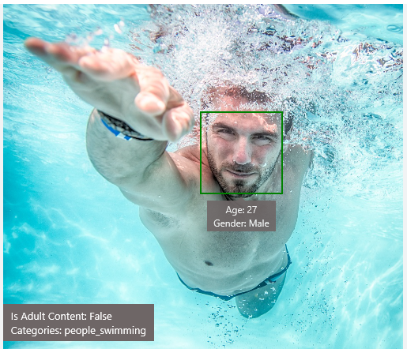
Analyze image
Type of image
Clip Art Type 0 Non-clipart
Line Drawing Type 0 Non-Line Drawing
Black & White Image False
Content of image
Categories [{ “name”: “people_swimming”, “score”: 0.099609375 }]
Adult Content False
Adult Score 0.18533889949321747
Faces [{ “age”: 27, “gender”: “Male”, “faceRectangle”: {“left”: 472, “top”: 258, “width”: 199, “height”: 199}}]
Image colors
Dominant Color Background White
Dominant Color Foreground Grey
Dominant Colors White
Accent Color

Slide 12

OCR
Good at
JSON:
{
"language": "en",
"orientation": "Up",
"regions": [
{
"boundingBox": "41,77,918,440",
"lines": [
{
"boundingBox": "41,77,723,89",
"words": [
{
"boundingBox": "41,102,225,64",
"text": "LIFE"
},
{
"boundingBox": "356,89,94,62",
"text": "IS"
},
{
"boundingBox": "539,77,225,64",
"text": "LIKE"
}
. . .
Scanned documents
Photos with text
Fine grained location information
LIFE IS LIKE
RIDING A BICYCLE
TO KEEP YOUR BALANCE
YOU MUST KEEP MOVING
Need to improve
Vehicle license plate
Hand-written text
Characters with large sizes

Slide 13




Smart thumbnail
Smart cropping on
Smart cropping off

Slide 14

Recognize emotions Detect emotions based on facial expressions in photos and videos
Emotion APIs
Notes:
How are you feeling? Can your app tell? With the Emotion API, you can build an app that recognizes emotions according to facial expressions—giving you the capability to provide an amazing, personalized experience.
Using facial expressions, this cloud-based API can detect happiness, neutrality, sadness, contempt, anger, disgust, fear, and surprise. The AI understands these emotions based on universal facial expressions, and it functions cross-culturally, so your app will work around the world.

Slide 15
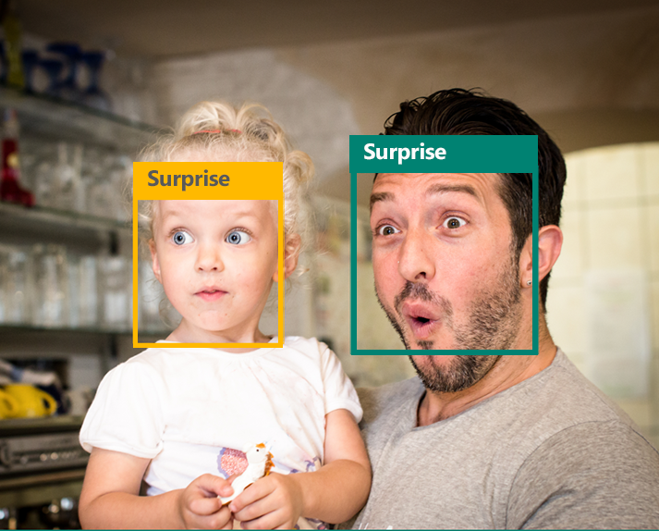
Emotion APIs
Face detection
"faceRectangle": {"width": 193, "height": 193, "left": 326, "top": 204} …
Emotion scores
“scores": { "anger": 5.182241e-8,
"contempt": 0.0000242813,
"disgust": 5.621025e-7,
"fear": 0.00115027453,
"happiness": 1.06114619e-8,
"neutral": 0.003540177,
"sadness": 9.30888746e-7,
"surprise": 0.9952837}

Slide 16

Face APIs
Face detection Detect faces and their attributes within an image
Face verification Check if two faces belong to the same person
Similar face searching Find similar faces within a set of images
Face grouping Organize many faces into groups
Face identification Search which person a face belongs to
Notes:
Detect human faces and compare similar ones, organize people into groups according to visual similarity, and identify previously tagged people in images.

Slide 17




Face APIs
Detection
"faceRectangle": {"width": 193, "height": 193, "left": 326, "top": 204}
…
Feature attributes
"attributes": { "age": 42, "gender": "male",
"headPose": { "roll": "8.2", "yaw": "-37.8", "pitch": "0.0" }}
Grouping
Identification
Jasper Williams

Slide 18


Video APIs
Stabilization Smooth and stabilize shaky video
Face detection and tracking Detect and track faces in videos
Motion detection Detect when motion occurs
Notes:
Intelligent video processing produces stable video output, detects motion, creates intelligent thumbnails, and detects and tracks faces.

Slide 19
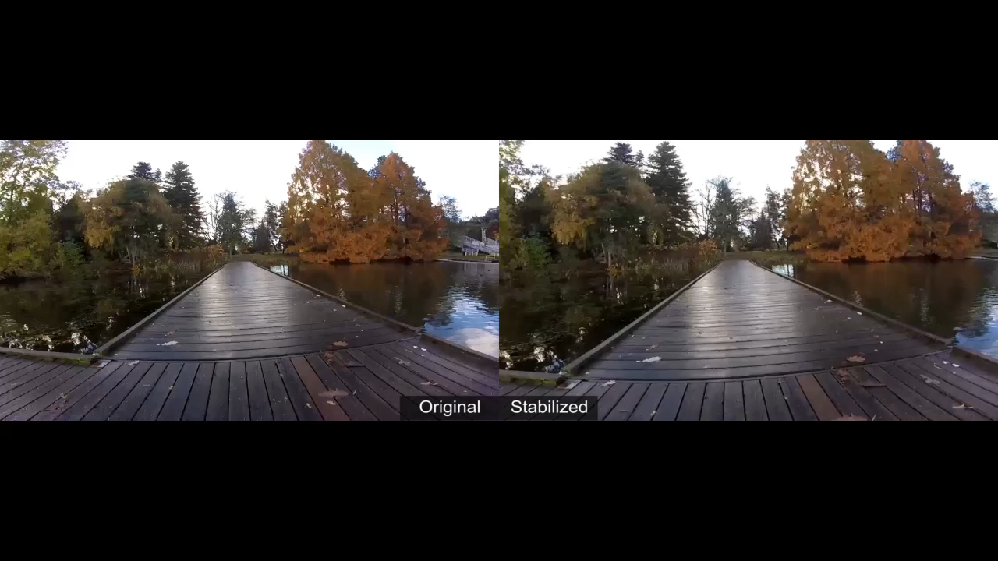
Stabilization
The Stabilization API provides automatic video stabilization and smoothing for shaky videos
This API uses many of the same technologies found in Microsoft Hyperlapse
Best For: Small camera motions, with or without rolling shutter effects (e.g., holding a static camera, walking with a slow speed)

Slide 20

Face detection and tracking
High precision face location detection and tracking
Can detect up to 64 human faces in a video (no smaller than 24x24 pixels)
Detected and tracked faces are returned with coordinates and a Face ID to track throughout the video
Time (sec) | Face ID | x, y | Width, height
0 | 0 | 0.59, 0.23 | 0.09, 0.16
0 | 1 | 0.38, 0.15 | 0.07, 0.12
1 | 0 | 0.54, 0.25 | 0.09, 0.15
1 | 1 | 0.23, 0.18 | 0.07, 0.12

Slide 21
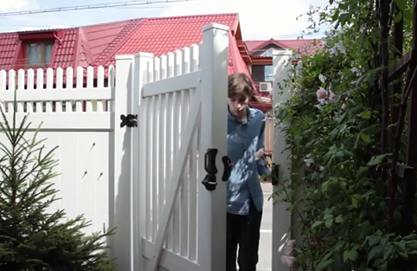
Motion detection
Indicates when motion occurs against a fixed background (e.g., surveillance video)
Trained to reduce false alarms, such as lighting and shadow changes
Current limitations:
No support for night-vision videos
Semi-transparent and small objects are not detected well
Start time | End time | In region
1.9 | 3.6 | 0
5.2 | 15.1 | 0

Slide 22
Speech
Hear and speak to your users by filtering noise, identifying speakers, and understanding intent
Custom Recognition | Speaker Recognition | Speech

Slide 23

Speech APIs
Voice recognition (speech to text) Converts spoken audio to text
Voice output (text to speech) Synthesize audio from text
Speech intent recognition Convert spoken audio to intent
Notes:
Convert audio to text, understand intent, and convert text back to speech for natural responsiveness.
Speech Intent Recognition can, in addition to returning recognized text from audio inputs, also return structured information about the speech to apps that parse the intent of the speaker and drive further actions by the app. Models trained by Project Oxford LUIS service are used to generate the intent.

Slide 24
Voice recognition
REST API
Client library
SUPPORTED PLATFORMS
Any
Windows, Android, iOS
DATA SUPPORT
Yes
Yes
MIC SUPPORT
No
Yes
SILENCE DETECTION ON MIC
No
Yes
LENGTH OF UTTERANCE
Short
Short and long
NUMBER OF RESPONSES
n-best response back
Multiple partial results, n-best (short), and multiple phrases (long)
Supports 7 languages: en-US, en-GB, zh-CN, it-IT, fr-FR, es-ES, de-DE
Same technology that supports Microsoft offerings of Xbox, Windows, and Cortana

Slide 25
Voice recognition
Short form
Long form
Duration of Audio | < 15 seconds | < 2 minutes
Final Result | n-best choice | Best choice, delivered at sentence pauses
Partial Results | Yes | Yes
450 6th St. San Francisco
********* Final N-BEST Results *********
[0] Confidence=Normal Text="450 six St San Francisco."
[1] Confidence=Normal Text="For 50 six St San Francisco."
[2] Confidence=Normal Text="456th St San Francisco."
[3] Confidence=Normal Text="450 six St in San Francisco."
[4] Confidence=Normal Text="456 St San Francisco."

Slide 26
Voice output
Synthesize audio from text via POST request
Maximum audio return of 15 seconds
17 languages supported
<speak version="1.0" xmlns="http://www.w3.org/2001/10/synthesis" xmlns:mstts="http://www.w3.org/2001/mstts" xml:lang="en-US">
<voice name="Microsoft Server Speech Text to Speech Voice (en-US, ZiraRUS)">
Synthesize audio from text, to speak to your users.
</voice></speak>
Synthesize audio from text, to speak to your users

Slide 27

Custom Recognition
Customize both language and acoustic models Tailor speech recognition to your app and environment
Notes:
Eliminate speech recognition barriers like speaking style, background noise, and vocabulary.
Does your speech recognition work with varied user populations, vocabularies, or with background noise? The Custom Recognition Intelligent Service (CRIS) helps you create custom speech recognition endpoints—so accents and environments are features, not challenges.
Customize your speech recognition by vocabulary and speaking style, create custom acoustic models to match the expected environment of your users, and tap into the API's powerful intelligence to create speech recognition endpoints customized to your app's needs. Turn language barriers into features with CRIS.

Slide 28
Custom Recognition Intelligent Service
Create custom language models for the vocabulary of the application
Adapt acoustic models to better match the expected environment of the application’s users
Deploy to a custom endpoint and access from any device
Record
audio
Adapt
Deploy
Transcribe

Slide 29
Speaker recognition API
“”
Speaker verification Check if two voices are the same
Speaker identification Identify who is speaking
Notes:
Your users' voices are their passports with the Speaker Recognition API. Your app can authenticate identities by using someone's voice, giving your users the capability to interact securely through speech.

Slide 30
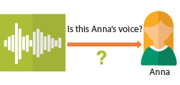
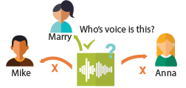
Speaker recognition APIs
“”
Enrollment
Create a unique voiceprint for a profile
Is this Anna’s voice?
Recognition
After enrolling one or more voices, identify who is speaking from an audio clip
Anna
Verification
Who’s voice is this?
Confirm if a voice belongs to a previously enrolled profile
Marry
Mike
Anna

Slide 31
Language
Process text and learn how to recognize what users want
Bing Spell Check | Language Understanding | Linguistic Analysis | Text Analytics | Web Language Model

Slide 32

Bing spell check APIs
State-of-the-art cloud based spelling algorithms Recognizes a wide variety of spelling errors
Recognize name errors and homonyms in context Difficult to spot errors that use the context of the words around them
Updates over time Support for new brands and coined expressions as they emerge
Notes:
The Bing Spell Check API corrects spelling errors, contextually recognizes names and slang, understands homonyms, and supports brand names.

Slide 33

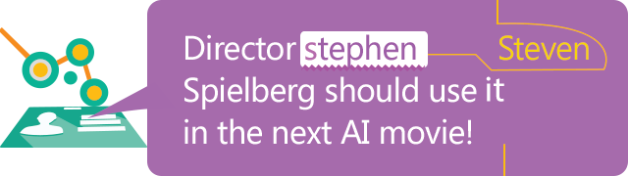

Bing spell check APIs
Check a single word or a whole sentence
“Our engineers developed this four you!”
Corrected Text: “four” → “for”
Identify errors and get suggestions
"spellingErrors": [
{
"offset": 5,
"token": "gona",
"type": "UnknownToken",
"suggestions": [
{ "token": "gonna" }
] }

Slide 34

Language Understanding
Understand what your users are saying Use pre-built Bing and Cortana models or create your own
Notes:
Understand language contextually, so your app communicates with people in the way they speak.
Do your apps understand language in the way people speak it—contextually? With the Language Understanding Intelligent Service (LUIS) API, you can integrate language models that understand your users quickly and easily. And if one of our preexisting models won't work, it will guide you through building your own.
Prebuilt models will recognize places, times, numbers, and temperatures, and handle common requests like "set an alarm for 8 AM." LUIS supports dialogue and action fulfillment, so your users can carry on a conversation with your app. For example, the input "schedule a meeting with Allison" results in the question "when?," allowing the user to respond "3 PM," and the meeting gets scheduled.

Slide 35
Language understanding intelligent service
Reduce labeling effort with interactive featuring
Use visualizations to gauge performance and improvements
Leverage speech recognition with seamless integration
Deploy using just a few examples with active learning
Define
concepts
Provide
examples
Deploy
Active learning

Slide 36
Language understanding models
{
“entities”: [
{
“entity”: “flight_delays”,
“type”: “Topic”
}
],
“intents”: [
{
“intent”: “FindNews”,
“score”: 0.99853384
},
{
“intent”: “None”,
“score”: 0.07289317
},
{
“intent”: “ReadNews”,
“score”: 0.0167122427
},
{
“intent”: “ShareNews”,
“score”: 1.0919299E-06
}
]
}
“News about flight delays”

Slide 37
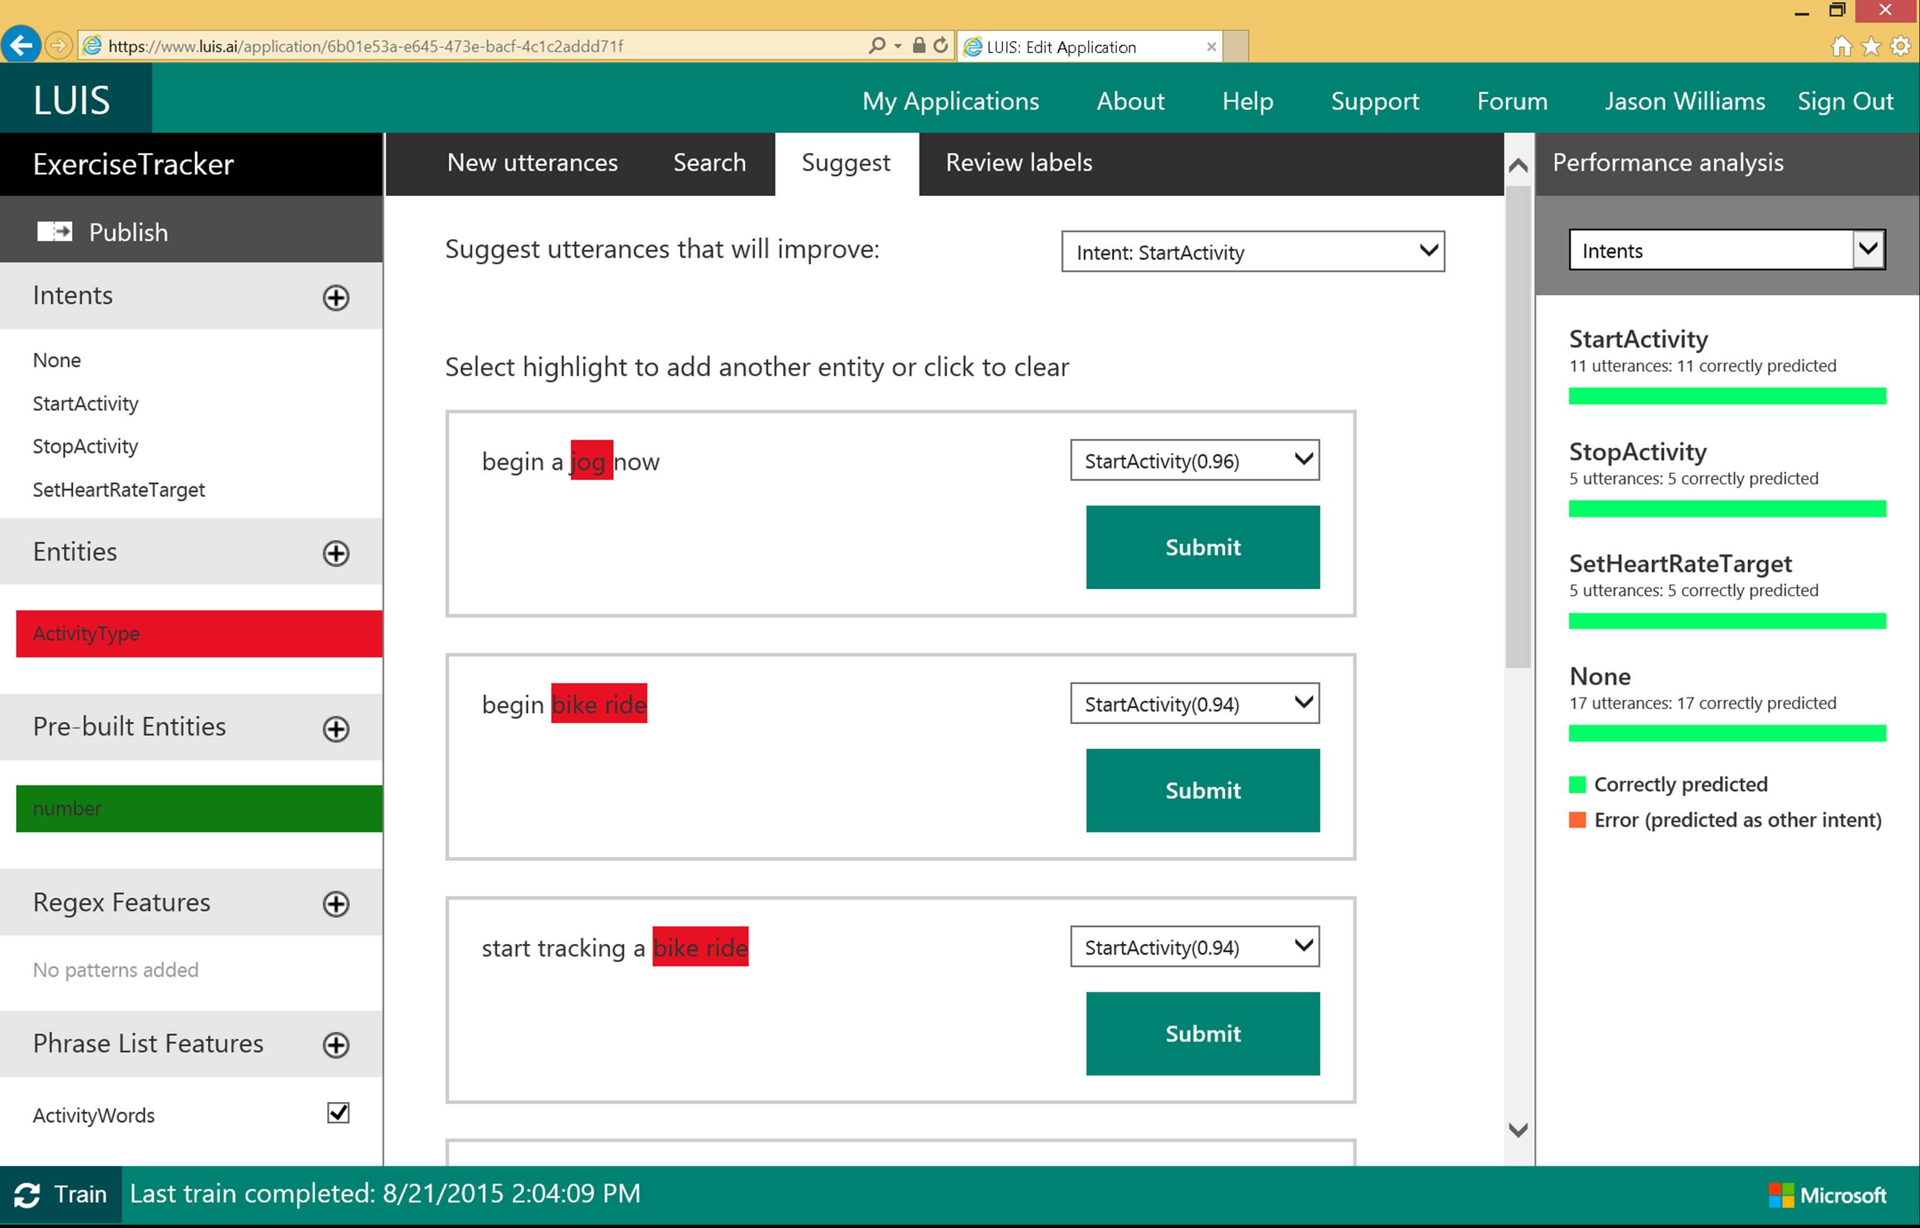

Slide 38

Linguistic analysis
Analysis tolls for natural language processing Access to part-of-speech tagging and parsing, identifying concepts, and actions
Notes:
You know what your users are saying, but do you know what it means? The Linguistic API uses advanced linguistic analysis tools for natural language processing, giving you access to part-of-speech tagging and parsing. These tools allow you to hone in on important concepts and actions. The API can tap into traditional linguistic analysis tools that allow you to identify the concepts and actions in your text with part-of-speech tagging, and find phrases and concepts using natural language parsers. Whether you’re mining customer feedback, interpreting user commands, or consuming web text, understanding the structure of the text is a critical first step. Try it out below!

Slide 39

Text analytics
Sentiment analysis Understand if a record has positive or negative sentiment
Key phrase extraction Extract key phrases from a piece of text, and retrieve topics
Topic detection Use clustering techniques to identify the trending topics on a large set of text records
Language detection Identify the language, 120 supported languages
Notes:
Understanding and analyzing unstructured text is an increasingly popular field and includes a wide spectrum of problems such as sentiment analysis, key phrase extraction, topic modeling/extraction, aspect extraction and more.
Text Analytics API is a suite of text analytics services : we currently offer APIs for sentiment analysis, key phrase extraction and topic detection for English text, as well as language detection for 120 languages. In this initial preview release, we offer APIs for sentiment analysis and key phrase extraction of English text. No labeled or training data is needed to use the service - just bring your text data. This service is based on research and engineering that originated in Microsoft Research and which has been battle-tested and improved over the past few years.

Slide 40

Web language model
Automation of a variety of standard natural language processing tasks using state-of-the-art language modeling APIs Word breaking, joint probability of natural language expressions, scoring, and predicting following words in a sequence
Notes:
Automate a variety of standard natural language processing tasks using state-of-the-art language modeling APIs.
Do you need to know how frequently certain words appear together? Or figure out which words a user might type next? Or how to break a hashtag into individual words? The Web Language Model API lets your app do all of this quickly and accuratel.

Slide 41
Knowledge
Tap into rich knowledge amassed from the web, academia, or your own data
Academic Knowledge
Entity Linking | Knowledge Exploration
Recommendations

Slide 42

Academic knowledge
Interpret Interprets a natural language user query string. Returns annotated interpretations which can enable rich search-box auto-completion experiences that anticipate what the user is typing
Evaluate Evaluates a query expression and returns academic knowledge entity results
Calchistogram Calculates a histogram of the distribution of attribute values for the academic entities returned by a query expression, such as the distribution of citations by year for a given author
Notes:
Tap into the wealth of academic content in the Microsoft Academic Graph using the Academic Knowledge API.
Do your users know who the top scholars have been in machine learning over the last three years? What about every paper authored by an expert like Li Deng from Microsoft? The Academic Knowledge API answers these and other questions by applying the Knowledge Exploration Service to the Microsoft Academic Graph. Users can start from natural language queries, or you can ping the graph directly through structured query expressions.
Additionally, the Academic Knowledge API can auto-complete natural language queries and return entity results, helping users narrow research results faster.
It can also create a histogram of attribute values for academic entries returned by a query—for example, the distribution of papers by year for an author.

Slide 43

Entity linking
Power your app's data links with named entity recognition and disambiguation A word might be used as a named entity, a verb, or another word form within a given sentence
The Entity Linking Intelligence Service will recognize and identify each separate entity based on the context
Notes:
Provide better user experiences by adding the Entity Linking Service to your app so that it can provide additional knowledge and facts from the web to supplement the text in context. The Entity Linking Service uses a prebuilt knowledge base to build links, and the option to acquire knowledge from your own data.
For example, your app may need to understand that "London, the capital" is the city of
London in the United Kingdom and not London, Ontario, or Jack London, the author.
The Entity Linking Service provides this information quickly and within context, offering a faster, more intelligent user experience.

Slide 44

Knowledge exploration Enable interactive search experiences over structured data via natural language inputs
Attribute histograms To enable rich visualization and interactive faceted experience
Structured query evaluation To efficiently retrieve detailed information about matching objects
Query auto-completion
To reduce user effort and help with discovery of rich capabilities
Natural language understanding
To interpret natural language queries into structured query expressions
Notes:
Do you have structured data for users to explore via natural language? The Knowledge Exploration Service takes structured data and linguistic resources you provide and creates a service that enables interactive search.
For example, as your users enter queries in a search box, the Knowledge Exploration Service offers auto-complete suggestions and semantic annotations. You can retrieve the top matching objects from the data, and you can create histograms of attribute values among the matches.

Slide 45


Recommendations
Increase catalog discovery Help customers easily discover items that they may be interested in
Personalize your experience Show suggestions that are targeted to each specific user
Increase the bottom line Increase your conversion rate by offering the right products at the right time
Notes:
The Recommendations API helps your customer discover items in your catalog.
Customer activity in your digital store is used to recommend items and to improve conversion in your digital store.
The recommendation engine may be trained by uploading data about past customer activity or by collecting data directly from your digital store. When the customer returns to your store you will be able to feature recommended items from your catalog that may increase your conversion rate.

Slide 46
Search
Access billions of web pages, images, videos, and news with the power of Bing APIs
Bing Web Search | Bing Image Search
Bing News Search | Bing Video Search
Bing Auto Suggest

Slide 47

Bing web search
Intelligent search to your apps with the ability to comb billions of webpages, images, videos, and news with a single API call Retrieve web documents indexed by Bing and narrow the results down with filters such as by answer type and freshness
Notes:
The Bing Search API adds intelligent search to your app, combing hundreds of billions of webpages, images, videos, and news to provide relevant results with no ad requirements. The results can be automatically customized to your users' locations or markets, increasing relevancy by staying local.

Slide 48

Bing image search
A variety of image search options, from trending images to detailed insights Scour the web for images and get results that include thumbnail and full image URLs, publishing website, image metadata, related images, and more
Notes:
The Bing Image Search API gives you powerful image searching tools with a single call. You can tap into trending images of people, places, and things from around the world, and filter results by image style, size, layout, date added, and license type.

Slide 49

Bing video search
A variety of advanced video search features, including trending videos, price, and other useful metadata Find videos from across the web and get responses that provide useful metadata including creator, encoding format, video size and quality, and source view count
Notes:
The Bing Video Search API offers robust video searching features with a single API call. You can receive information from around the world about trending videos, updated on a daily basis. Search results can be returned by either a static image or a motion thumbnail, allowing you to customize how your users see what they're looking for.

Slide 50

Bing news search
Turn any app into a news desk with world news grouped and filtered by topic, local news, and metadata you can mine
Notes:
The Bing News Search API can help turn your app into an up-to-date news center. Results from a single call bring trending news from around the world, which is updated in near-real time, so users can be kept up to date on whatever's happening in their neighborhood—or across the globe.

Slide 51

Bing auto suggest
[
Query completion suggestions capabilities, so users can type less and get to what they want faster
Notes:
Whether you're searching the web, a local set of data, or just asking users to enter an input into your app, the Bing Autosuggest API helps narrow the search quickly by allowing your users to see suggestions for popular search terms. It can correct perceived mistakes, and returns detailed contextual suggestions according to other searches people have found useful.

Slide 52

Get started now
Learn more on the Cortana Intelligence Suite website and Cognitive Services website
Schedule a workshop to identify areas in your business where analytics and intelligence can drive transformation
Talk with your Microsoft contact about licensing options and partners
Notes:
Cortana Intelligence is available as a simple monthly subscription, which gives you a predictable monthly cost for building a comprehensive Big Data and advanced analytics solution.
Learn more about Cortana Intelligence and Cognitive Services through our websites, by scheduling a workshop to determine where our solution may help, or by speaking with your Microsoft contact about licensing options and trained partners in your area that can help you get the most out of the solution.
T: Thanks for your time.

Slide 53
Q&A

Slide 54

© 2016 Microsoft Corporation. All rights reserved.

